Slide 1


From Planck’s Constant to Quantum Mechanics
Matteo Mascolo

Slide 2
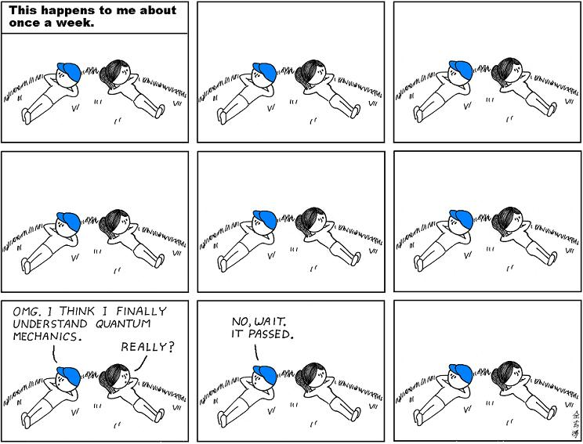
Don’t be afraid ...
... if you don’t understand QM ...

Slide 3
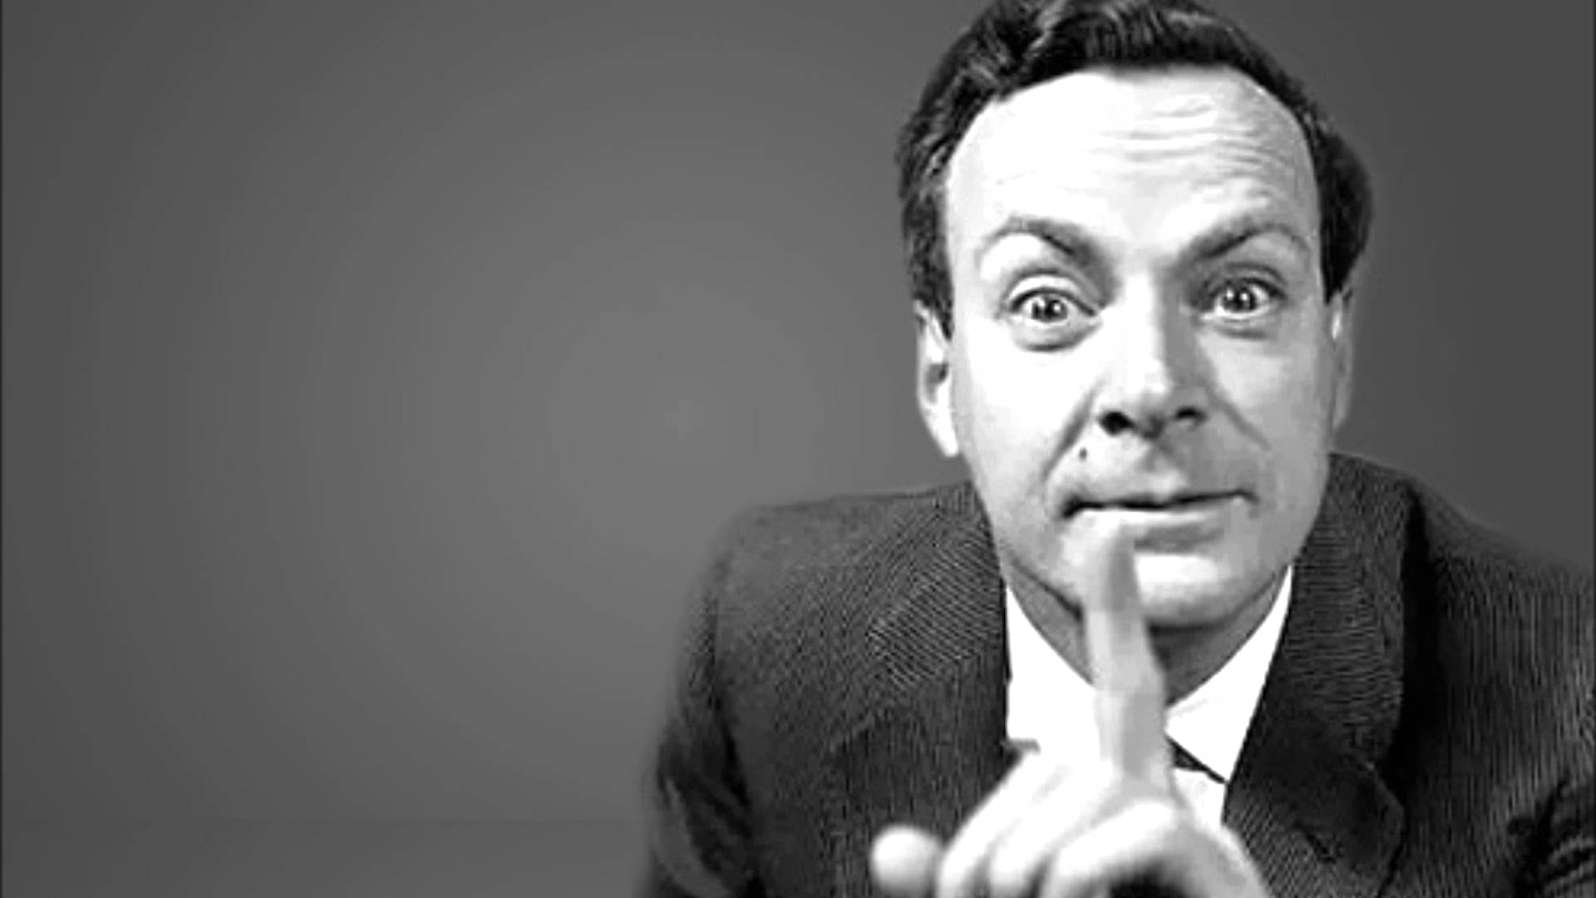
Don’t be afraid ...
... you are in good company !
“I think I can safely say that nobody understands quantum mechanics “
(R. P. FEYNMAN)

Slide 4
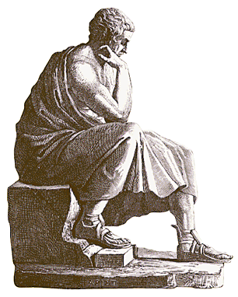
Let’s start from the very beginning
Physics before Galileo Galiei (1622). According to Aristotele....
A constant force produces a uniform motion
F = m v
The speed of a body in vacuum is infinity

Slide 5
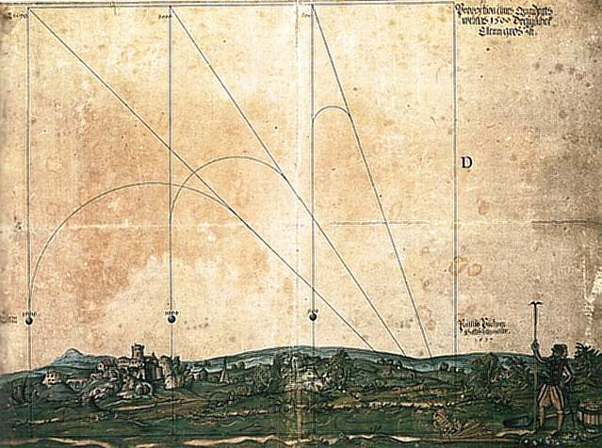
Something is evidently wrong

Slide 6
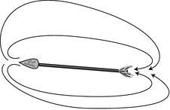
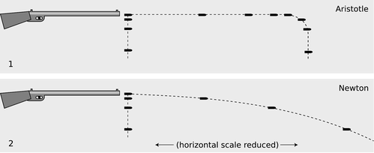
No way to understand it !!
Two easy observations can show the lacks of Aristotelian mechanics
It hardly explains how an arrow keeps on flying after being shot (Aristotele tried with the theories of “natural places” and the “horror vacui”)
1)
2)
Trajectories can be easily disproved through a simple experiment (throwing an arrow and looking its motion!!)

Slide 7

Aristotelian physics is WRONG!

Slide 8
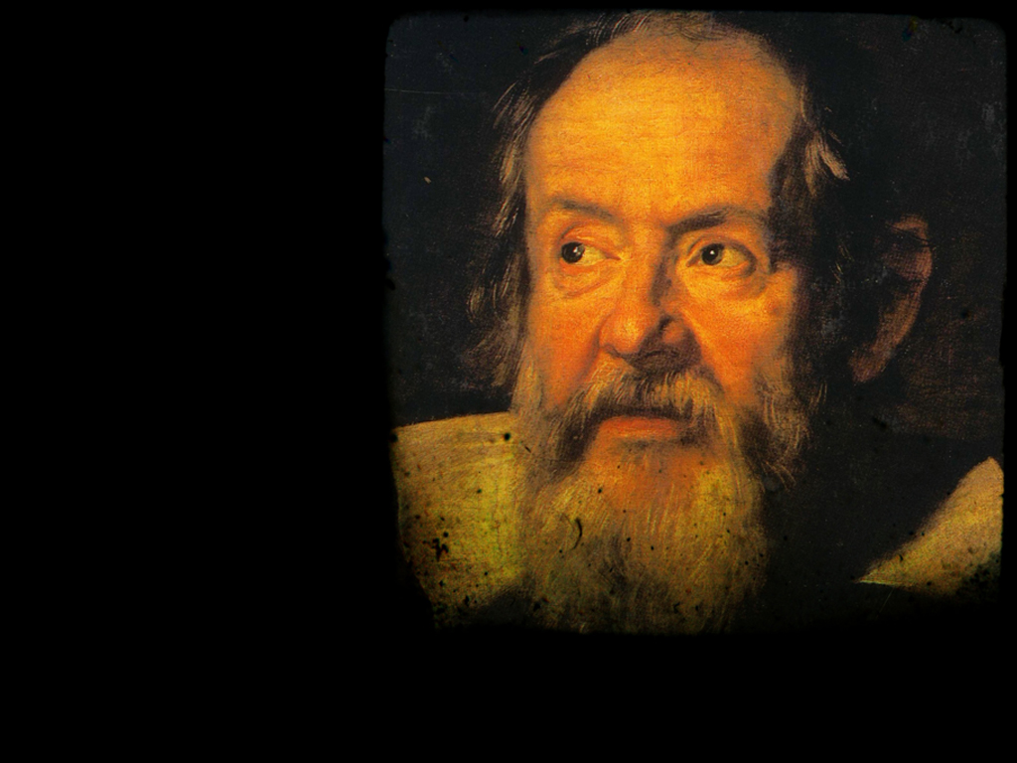
One more easy thing ...
SCIENTIFIC METHOD (1622)
- Observation of phenomenon
- Hypothesis and prediction
- Experiment
- Write a law using the
“language of mathematics”
- Falsifiability of the law
- Prediction capabilities

Slide 9
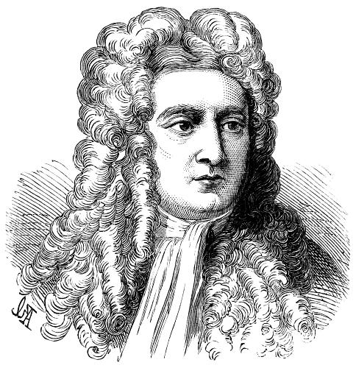
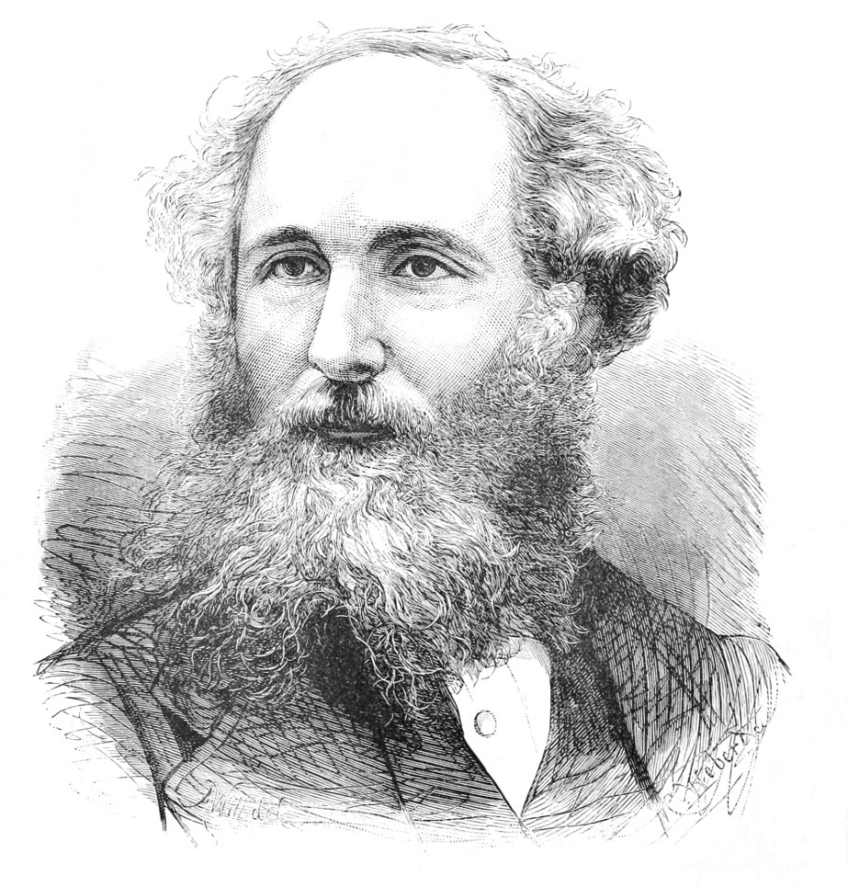
The best “EPIC FAIL” ever ...
“ [It’s 1874] ... the task of physics is nearly completed. There are a few minor things left to do: measure some quantities with higer precision and find a theoretical justification for the black body radiation ... ”
1643-1727
1831-1879

Slide 10
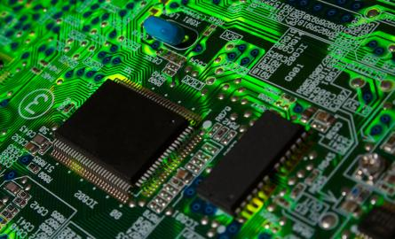
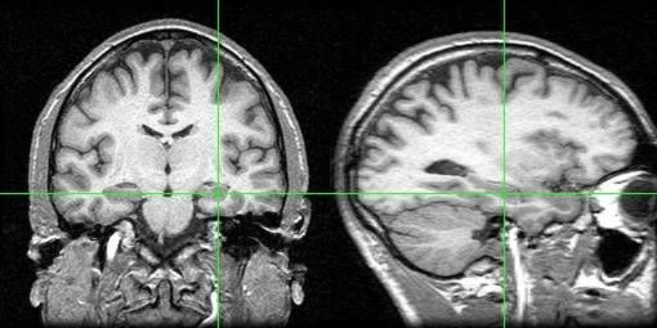
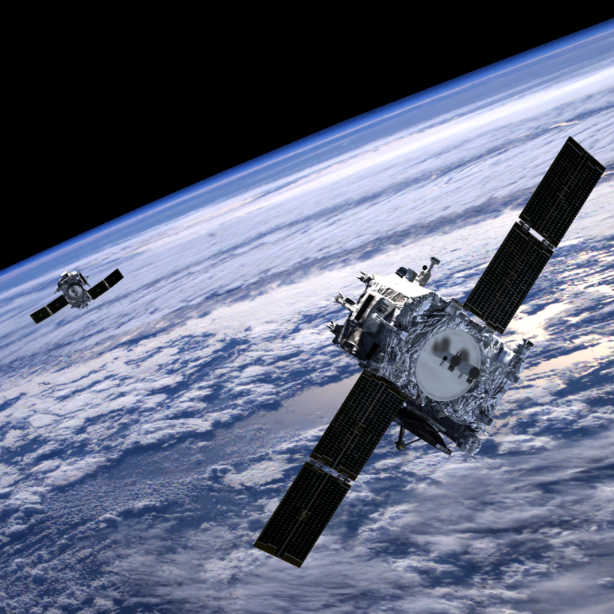
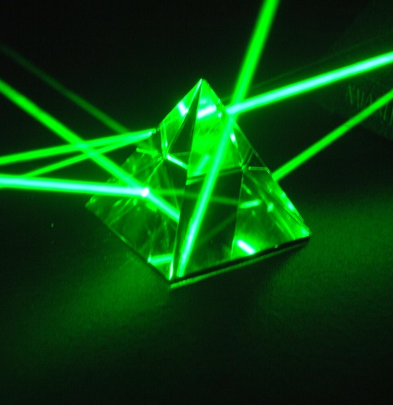
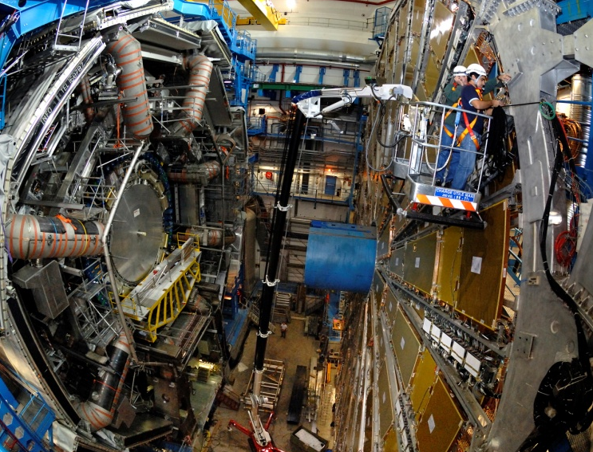
But ... we knowk what came after !

Slide 11
Than the questions are:
Is classical mechanics as wrong as Aristotelian mechanics?
How can classical mechanics, relativity, and quantum mechanics to reconcile?
Every theory has its own scope of validity, one has to know its limits!
For example, how is the atom made?

Slide 12

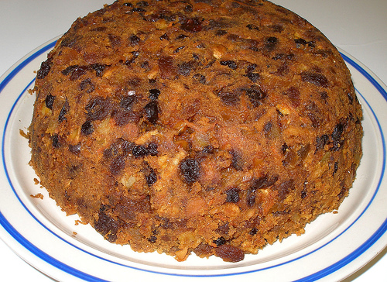
A short excursus ...
The ‘Plum Pudding’ model
The ”The atoms […] consist of a number of negatively electrified corpuscles enclosed in a sphere of uniform positive electrification…”
[J.J. Thomson]

Slide 13
The limits of Thomson model
The electron is the only charged particle having mass, thus every atom should contain a very huge number of particles
It does not explain the different attitude of chemical elements to ionize and combine together
It does not explain absorption and emission lines of elements
It does not explain the results coming from scattering experiments
3 out of 4 points solved by the Thomson’s pupil : Prof. ‘Crocodile’

Slide 14
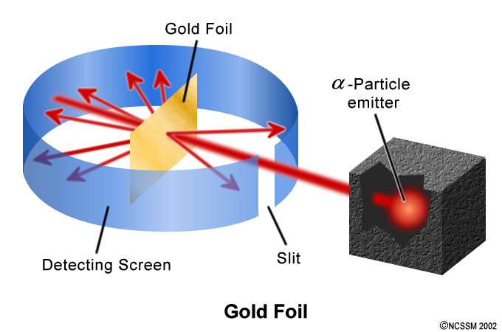
The Geiger-Marsden experiment
(aka the Rutherford experiment )
Scattering of a-particles (nuclei of Helium) on a thin foil of gold. Scattering effects were evaluated ‘’by eye’’, working in the dark and assuming drugs that dilated the pupila

Slide 15
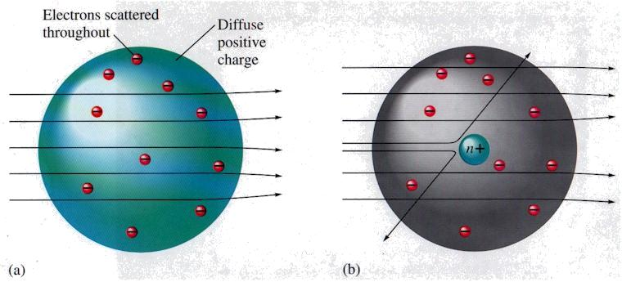
Thomson vs Rutherford
THOMSON ATOM
RUTHERFORD ATOM

Slide 16
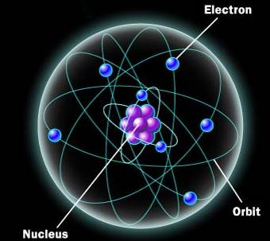
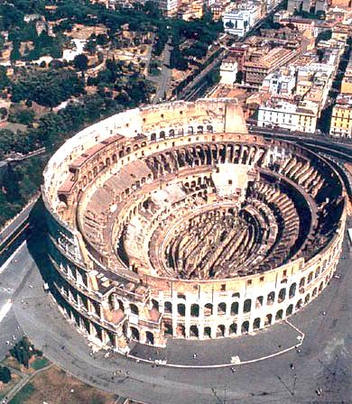

Rutherford modeling of the atomù
(Nobel Prize 1908)
Negatively-charged electrons orbit around a positively charged nucleus (no neutrons yet!)

Slide 17
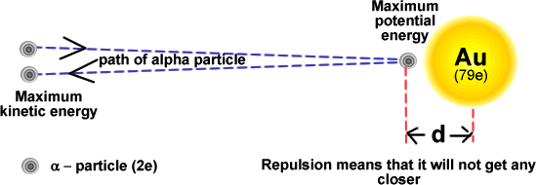
How big is an atom ??
The total energy is the kinetic energy of the α-particle T plus the Coulomb-energy V due to the repulsion between charges of the same sign. When the particle turns back T=V.

Slide 18
How big is an atom ??
Given the elementary charge e, the dielectric constant of vacuum ε₀ and the kinetic energy T
At that time, the radius of the atom of gold was well known: 150’000 fm. It is 3000 times larger!

Slide 19

3000 times larger it’s a lot !!!

Slide 20

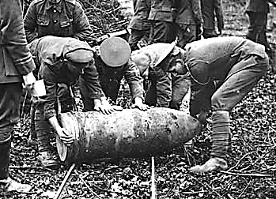
A new model of the atom
“It was quite the most incredible event that has ever happened to me in my life. It was almost as if you fired a 15-inch shell into a piece of tissue paper and it came back and hit you […]
[…] this scattering backward must be the result of a single collision, and when I made calculations I saw that it was impossible to get anything of that order of magnitude unless you took a system in which the greater part of the mass of the atom was concentrated in a minute nucleus. It was then that I had the idea of an atom with a minute massive center, carrying a charge. “
[E. Rutherford]

Slide 21
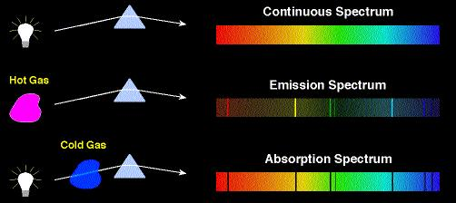
The limits of the Rutherford model
Electrons are charges in motion and they should lose energy by emitting radiation (Maxwell - Hertz 1888)
They should fall on the nucleus in 10⁻¹⁰ seconds
The puzzle of spectral lines is still unsolved !

Slide 22
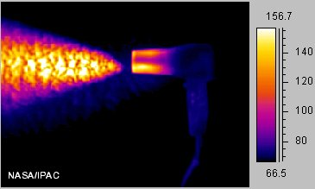
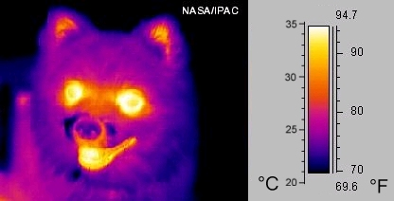
The emission of radiation
Every object at a given temperature emits energy in the form of electromagnetic radiation (the common “heat”)
An object emits radiation at all the wavelengths (λ), but the distribution of the emitted energy as a function of λ changes with the temperature (T).

Slide 23
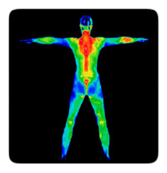
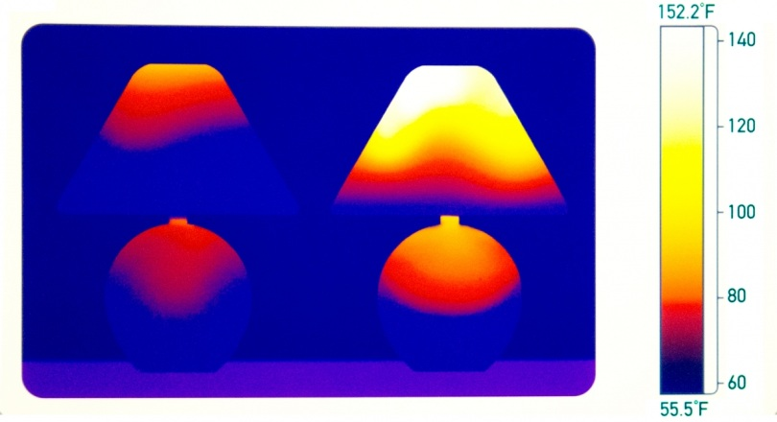
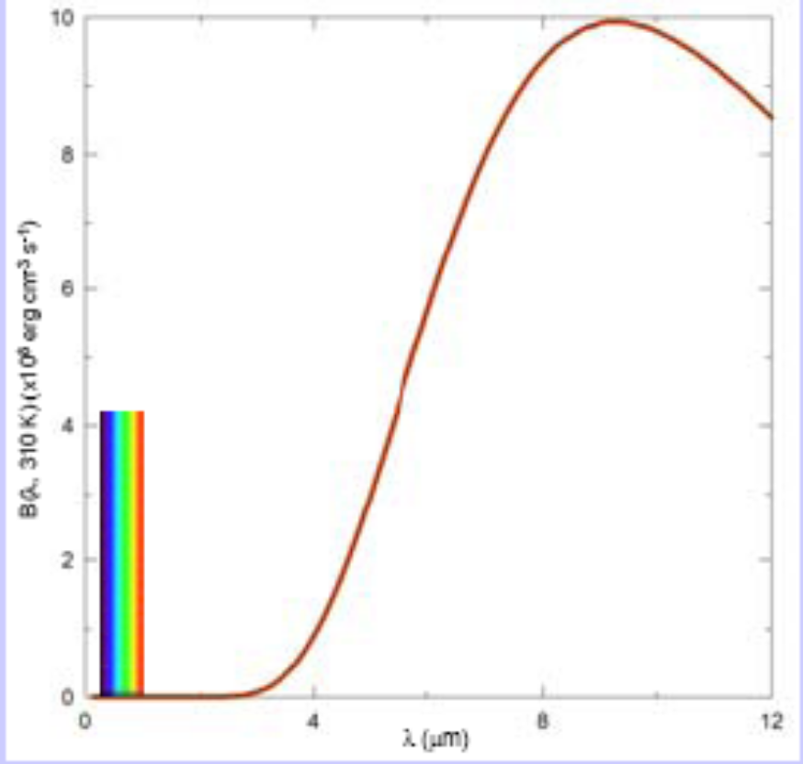
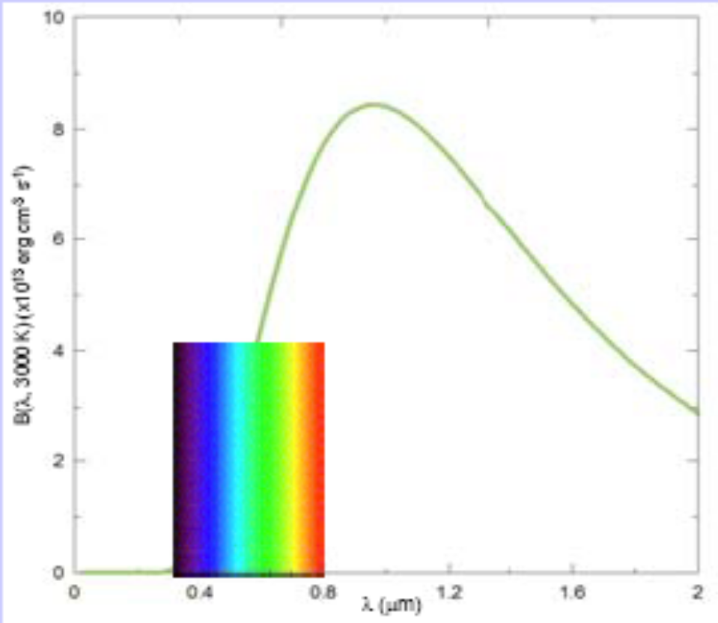
Some emission spectra

Slide 24

The “Black Body”
A body is composed of many oscillating charges.
Their oscillations increase if temperature T increases
Oscillating charge emit radiation and slow down.
That is how bodies cool down
Body at equilibrium have emissivity equal to absorption
e = a for every value of T and λ
Body at high temperature T absorb all the energy they emit, so in this case: (at equilibrium) e = a = 1 .
Such a body do not emit radiation and appears to be black hence the name of “black body”

Slide 25
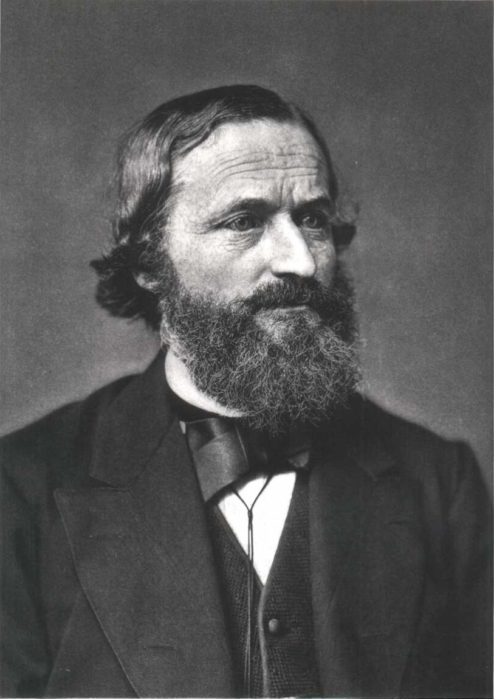
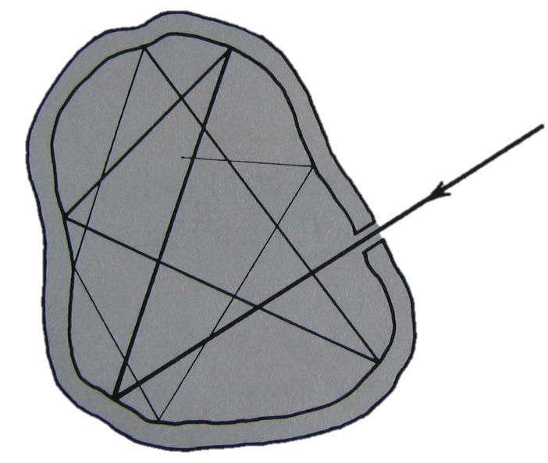
Kirchhoff and the black body
A black body is a cavity (e.g. an oven) with a tiny hole, kept at a constant temperature.
The radiation entering the black body is reflected by the inner walls a huge number of times before getting out.

Slide 26
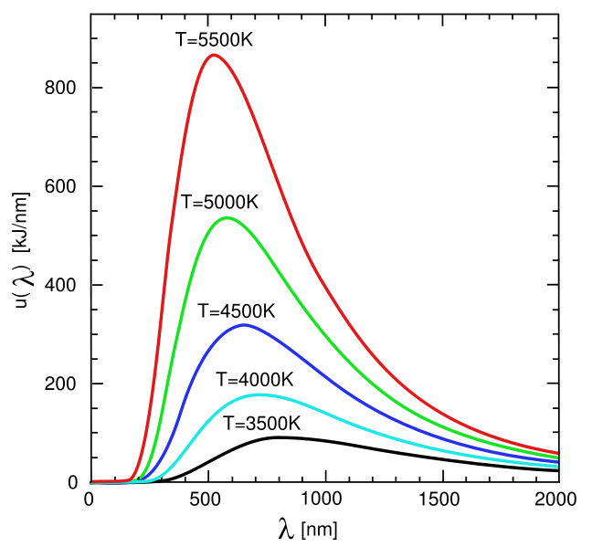
The black body spectrum
All black bodies at the same temperature emit thermal radiation with the same spectrum (regardless of shape, dimensions and material)
From spectra observation:
λ_{max}T = constant
Wien’s law
Μ_{tot} α T⁴
Stefan (1879)
From theoretical calculation:
Μ_{tot} = εσT⁴
Boltzmann (1879)

Slide 27
The black body “puzzle”
The flux of the radiation within the cavity in every direction is zero, but there is energy transfer everywhere
This transfer is given by the density of radiated energy in the wavelength range (λ, λ+dλ) : Ψ_{λ}dλ
The calculation of Ψ_{λ} giving the shape of expected experimental spectrum, was very difficult from th theoretical point of view
First Attempt ... by Wien
(First “empirical” forumla)

Slide 28
The black body “puzzle”
Wien’s Ψ_{λ} does not work! It fits data at low λ not at high λ. Constants C e C’ are completely arbitrary!
Second Attempt ...
by Rayleigh-Jeans
Model with stationary waves inside the cavity. The energy density is evaluated as the density of modes with mean kinetic energy kT
It does not work! It fits data only at high λ. Smaller is λ greater is the number of possible stationary waves! But everything was calculated correctly…

Slide 29
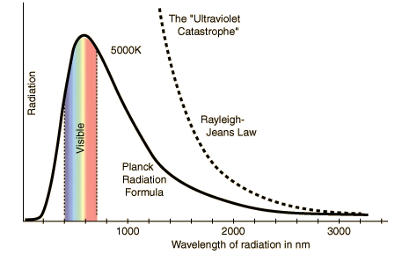
The “ultraviolet catastrophe”
Wien: empirical formula, correct only for small values of λ
Rayleigh-Jeans: consistent formula, correct for big λ
AND NOW?!?!

Slide 30
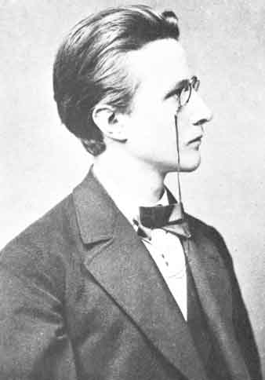
PLanck’s lucky solution
OCTOBER 1900
Max Planck solves the puzzle of the spectrum of black body radiation. With a new empirical formula:
What are the constants C and C’ !?
It works for every value of λ!
Yeah but ... WHY?!?!
1858-1947

Slide 31
PLanck’s lucky solution
The agreement with Rubens’ experimental data is striking.
Nevertheless Planck can’t find a physical explanation...

Slide 32
The “desperate act”
“[...] something which started innocuously as the color of light from burning coal had developed into a phenomenon with much deeper meaning.”
“A theoretical explanation must be found, no matter how far from the present knoledge”
[Max Planck]
After countless attempts based on classic approach, Planck makes a “desperate act”, denying the continuity of Nature laws.
It’s December 1900.

Slide 33

Planck’s idea ...
Oscillators of frequency f in the black body cavity can exchange only certain amounts of energy, multiple of a fixed value, called quantum of energy depending upon the frequency f :
( h is the Planck’s constant, extracted from data : [h] = [J][s] also called ‘’action’’ )
This idea allows to limit the high-frequency part of the spectrum and solves the ultraviolet catastrophe: the larger is the value of En, the more difficult is the exchange of energy, because it would change the equilibrium status of the cavity!

Slide 34
Getting ready for calculation ...
Planck disagreed with atomic theories, and did not like statistical thermodynamics…
Nevertheless, Planck took his start from Boltzmann’s statistical approach, stating that the number of oscillators with energy between E and (E + dE) is given by
The mean value of the energy of the oscillators (at fixed λ) is:
The fraction of oscillator with energy in the range(E, E+dE) is:

Slide 35
Planck’s calculation (1/3)
In the continuum hypothesis (pre-Planck) thus:
Multiplying this mean energy (of the oscillators at a fixed frequency) by the number of ‘’modes’’ (i.e. the number of possible frequencies), one obtains Rayleigh-Jeans formula!
In Planck’s discrete hypothesis:
N₁ particles with energy hf :
N₂ particles with energy 2hf :
N₃ particles with energy 3hf :
Etc …

Slide 36
Planck’s calculation (1/3)
Let’s call:
and let’s stop at 3rd term
but:
LOOKS
FAMILIAR ??!

Slide 37

The Planck’s formula
Try to figure out Planck’s face when he saw exactly his “lucky formula”, coming out from calculation without any mathematical trick (constants included) !!

Slide 38
The Planck’s formula
Planck’s formula reproduces the black body spectrum in the whole f range …
Low f (big λ)
Wien
High f (small λ)
RJ
Reminder (if x is small):

Slide 39

The Planck’s constant
h is a fundamental constant, playing a fundamental role in the quantum theory
(when divided by 2π, it is referred to as h-bar)
(When multiplied by the frequency) it defines the ‘quantum of energy’ (the minimum quantity of energy which can be exchanged)
Represents the connection between the wavelength and momentum of particles (wave-particle duality!)
It defines the scale at which the natural phenomena become “quantistic” (and classical behavior disappears)

Slide 40
What does it mean ???
“I tried for many years to save physics from
discontinuous energy levels…”
[Max Planck]
There is no way for classical physics to explain the black body spectrum;
Not all values of energy can be exchanged. Energy levels are discrete or quantized;
Quantum theory is born. Other weird behaviors of Nature can be explained in the light of quantum mechanics (see in a while…)!

Slide 41
How can it be like that ?!?!
“ Nobody knows how it can be like that !! “
(R. P. FEYNMAN)

Slide 42
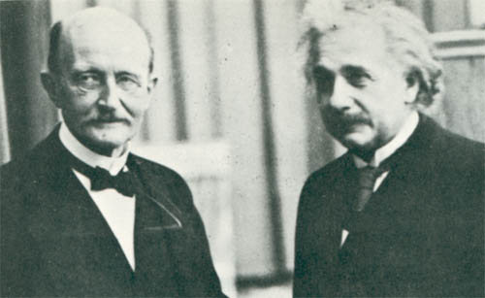
The skepticism and the genius
No one is able to accept the quantum hypothesis (not even Planck himself!!), except one (really outstanding) man, who immediately understood the power of the theory, absorbing and developing it in only 5 years !!!

Slide 43
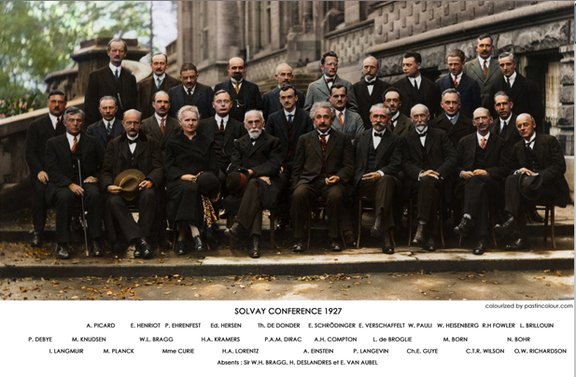
The quantum mechanics was born...

Slide 44
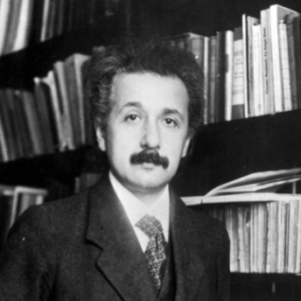
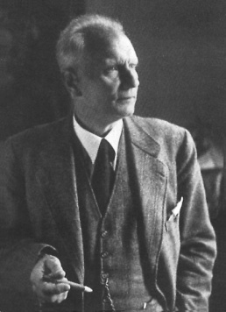
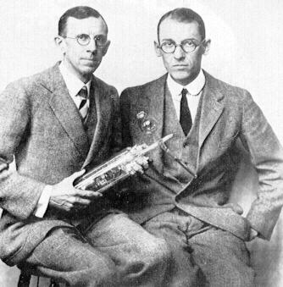
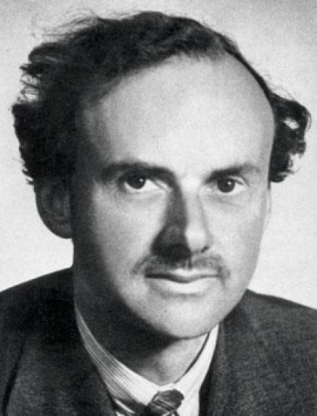
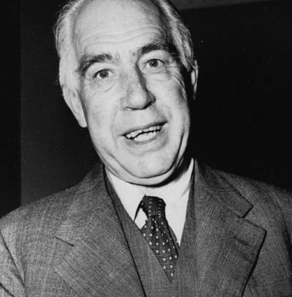
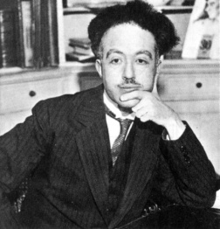
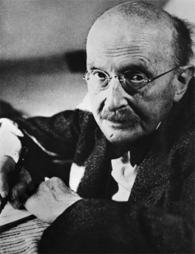
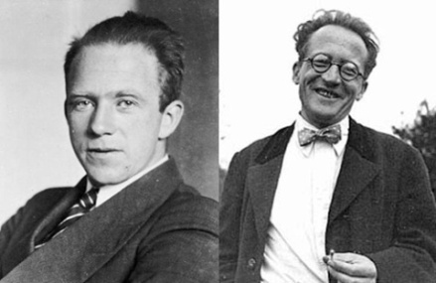
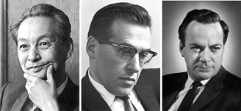
The evolution of quantum mechanics
1900
1905
1913
1922
1924
1925
1926
1928
1965

Slide 45
That’s it for the moment ....

